Slide 1
WorldSkills Abu Dhabi 2017 School visits:
Teachers briefing
With the support of ALL UAE EDUCATION ENTITIES

Slide 2
Agenda
What is WorldSkills Abu Dhabi 2017
Why is it important for the UAE
What happens in WorldSkills Abu Dhabi 2017
Facts and Figures
How we make it happen
ADNEC, the venue
The 17 steps you need to do the day of the visit
Do’s & Don'ts
Prohibited items in venue
Checklist
Keep in touch with us
Open Forum… the moment for questions

Slide 3
WORLDSKILLS ABU DHABI 2017

Slide 4
What is worldSkills abu dhabi 2017?
1947
Founded in in Spain, WorldSkills is now
the world’s biggest skills competition.
Leipzig (Germany) – 2013
Sao Paulo (Brazil) – 2015
Abu Dhabi (UAE) – 2017
Kazan (Russia) – 2019
London (UK) – 2011
51 Skill competitions
1300 Competitors
77 Member countries

Slide 5
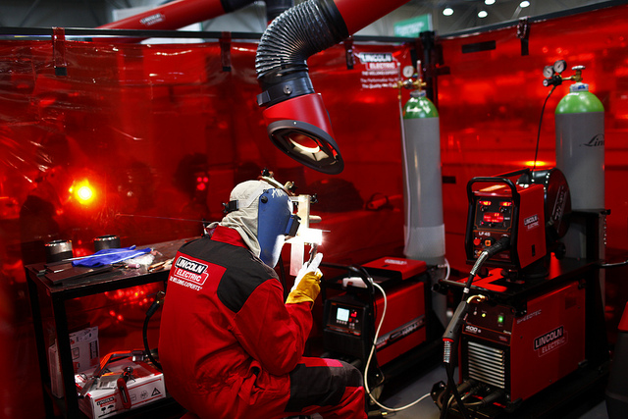
Why is it important for the uae?
WorldSkills Abu Dhabi 2017 (WSAD2017) is held under the patronage of His Highness Sheikh Mohamed bin Zayed Al Nahyan, Crown Prince of Abu Dhabi and Deputy Supreme Commander of the UAE Armed Forces.
WSAD2017 aims to raise awareness of:
The importance of vocational skills
The role of skills in a post-oil economy
These are outlined in UAE’s plan for economic development.

Slide 6
What happens during worldSkills Abu Dhabi 2017?
51 Skill Competitions take place at ADNEC over 4 days (15th to 18th October).
Skills range from Aircraft Maintenance and Robotics to Graphic Design and Fashion Technology.
Competitors are aged 16-22 from 77 different countries.
But you don’t just have to watch!

Slide 7
Facts and figures
80,000 students
(plus 5,000 supervisors approx.)
4 days of competition
20,000 students per day
Arrival of 2,000 students every 30 minutes
Expected between 500 – 700 school buses per day
 | 15 October (C1) | 16 October (C2) | 17 October (C3) | 18 October (C4)
ADNEC operating hours | 10:00 – 17:00 | 09:00 – 17:00 | 09:00 – 17:00 | 09:00 – 16:00
IPIC Arena operating hours | 09:15 – 17:30 | 08:15 – 17:30 | 08:15 – 17:30 | 08:15 – 16:30

Slide 8
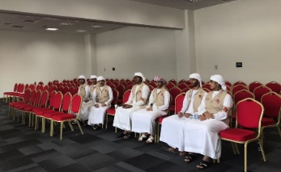
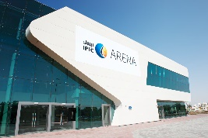
What do you need to do to visit worldskills abu dhabi 2017?
HOW DO WE MAKE IT HAPPEN: THE LOGISTICS
School buses travel from around the UAE
Students are shuttled back to IPIC Arena (by WSAD2017)
Students walk back to load zone
Schools organize transportation (buses) to IPIC Arena
Upon arrival, each bus gets a number and the same one is given to the teacher
Students experience at ADNEC
Schools wait until their bus is called from parking area to load zone. Holding area will also be for meal bags distribution
Buses lined up at load zone. Schools find their buses and depart back to school
Students walk from load zone to IPIC Arena (registration check and security screening)
Students are shuttled to ADNEC (by WSAD2017)

Slide 9
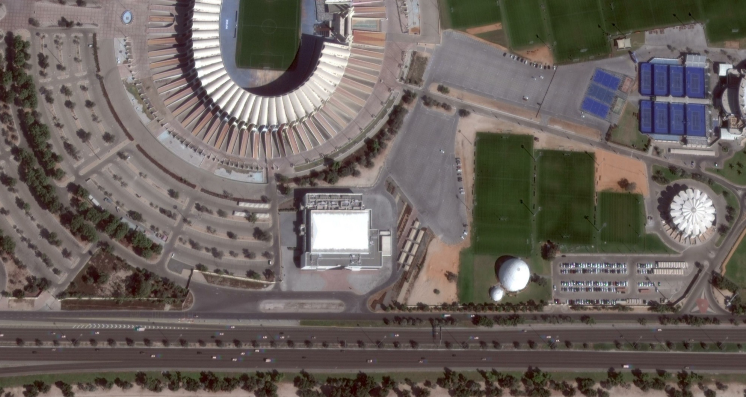
What do you need to do to visit worldskills abu dhabi 2017?
BUS FLOW IN SATELLITE VENUE – IPIC ARENA (Zayed Sports City)
SCHOOLS ENTRANCE
SCHOOLS EXIT
ACCESS TO SHUTTLE BUSES
ARRIVAL OF SHUTTLE BUSES POST ADNEC VISIT

Slide 10
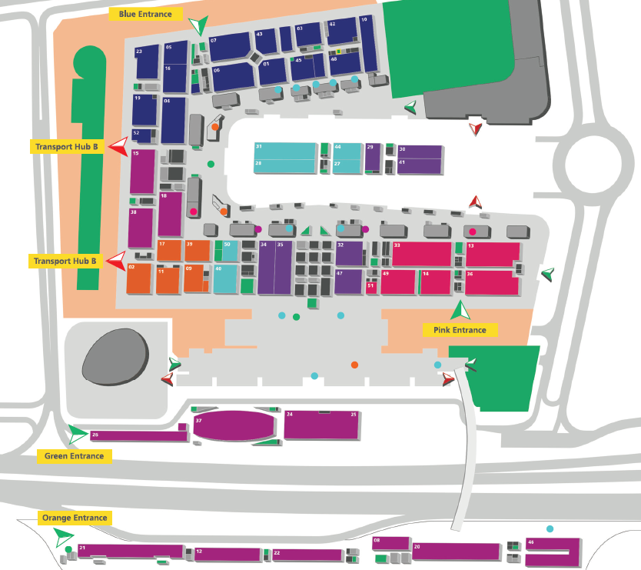
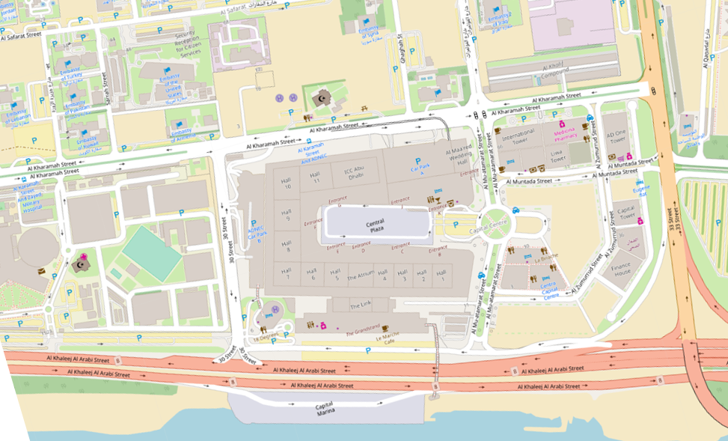
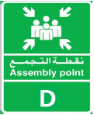
ADNEc, the venue

Slide 11
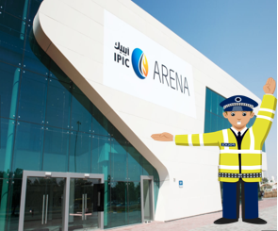
The 17 steps you need to do the day of the visit
1. School Bus (Emirates Transport) picks up school visits coordinator, supervisors and students.
2. Bus driver puts in the windscreen the bus signage provided by the school visits coordinator.
3. All supervisors must have a badge. Wristbands are distributed to students.
4. School bus travels to Abu Dhabi, following signage to Zayed Sports City.
5. Arrival to IPIC Arena: follow marshals instructions.
6.The WorldSkills Abu Dhabi 2017 team will proceed with a registration check.
7. School bus drops off the group.
8. School bus driver and school visits coordinator will be provided with a bus number. Driver must place it in the windscreen and teacher keep it throughout all the visit.

Slide 12
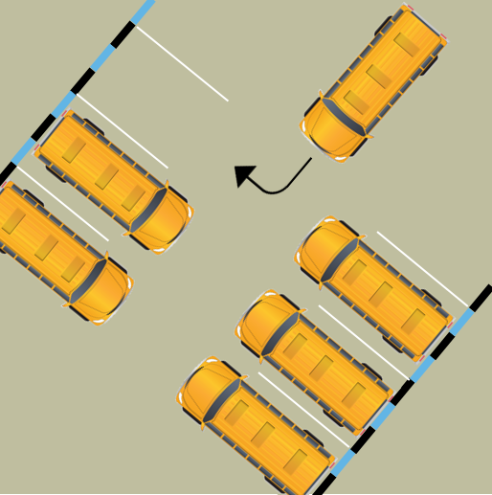
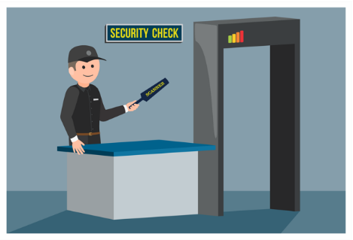
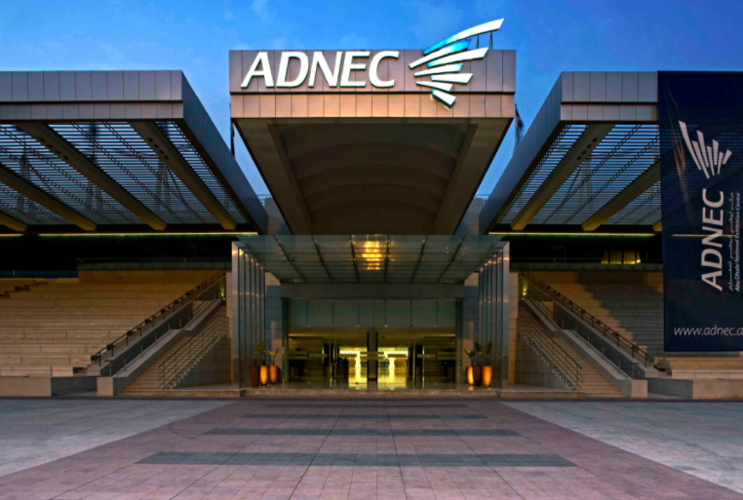
The 17 steps you need to do the day of the visit
9. The bus departs to a parking area following WorldSkills Abu Dhabi 2017 instructions.
10. Students with supervisors will enter IPIC Arena and proceed with security screening.
11. The group will receive key information about their visitor experience while walking towards the shuttles.
12. School shuttles will transfer safely the students and supervisors to ADNEC.
13. Groups arrive to ADNEC and will have a maximum 2 hours experience.
14. Teachers must provide their bus number before leaving ADNEC so the WorldSkills Abu Dhabi 2017 team will get their school bus ready at IPIC Arena.
15. Students and teachers depart from ADNEC back to IPIC Arena with the WorldSkills Abu Dhabi 2017 shuttles.
16. Back in IPIC Arena, students and teachers will receive a meal bag.
17. Once the school bus is at the departure load zone, the group leaves IPIC Arena and departs back to school.

Slide 13
Do’s & don’ts
Arrive to IPIC Arena, always be on time…..

Slide 14
Do’s & don’ts
Bring more students or supervisors than registered …..
2
4
?!
1
3
5

Slide 15
Do’s & don’ts
Come on the date and time you registered …..

Slide 16
Do’s & don’ts
Leave bags in the bus before drop off …..

Slide 17
Do’s & don’ts
Bring valuable items to the venue …..

Slide 18
Do’s & don’ts
Mix different grade groups in one registration …..

Slide 19
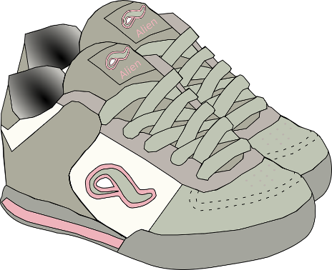
Do’s & don’ts
You will be on your feet most of the time so wear …..?

Slide 20
Do’s & don’ts
Students can only leave the venue by their …..?

Slide 21
Do’s & don’ts
Respect the health and safety rules …..

Slide 22
Do’s & don’ts
Make sure your students are always under supervision, you are fully responsible for their behaviour and safety …..

Slide 23
Do’s & don’ts
Make sure you know what is your bus number (information provided upon arrival to IPIC Arena) and provide it to the WorldSkills Abu Dhabi 2017 team upon departure from ADNEC …..

Slide 24
Do’s & don’ts
Ask for assistance if you are bringing a special needs / people of determination group …..

Slide 25
Do’s & don’ts
Respect security and crowd management instructions …..

Slide 26
PROHIBITED ITEMS IN VENUE
For security reasons, some items will not be allowed in venue. Please, ensure you don’t bring them with you.
No Alcohol Allowed
No Weapons Allowed
No Lighters Allowed
No Scooter Allowed
No Trolleys Allowed
No Pets Allowed

Slide 27
Teacher’s checklist
Task
I have registered in advance and received confirmation from the WorldSkills Abu Dhabi 2017 team about my visit to the event.
I have provided all required personal data in advance to produce the accreditation for all school coordinators and supervisors.
I have booked and planned the transportation from my school to IPIC Arena and back, in advance.
I have the parental approval for all the students to attend this trip as well as their agreement to be photographed as media will be present in the venue.
I am well aware of the date and time slot I need to arrive at IPIC Arena for the visit.
I have read about WorldSkills Abu Dhabi 2017 and planned the day of the visit with my students.

Slide 28
Teacher’s checklist
Task
I understand that for logistical and security reasons, my school bus will drive to IPIC Arena, where we will disembark and proceed with the registration check and security screening prior being transferred to ADNEC by the WorldSkills Abu Dhabi 2017 team.
I have my badge (as without it, I cannot access the venue). All adults require a badge to access the venue and are fully responsible of the behaviour, security and safety of their students.
I have the wristbands for all my students (as without them, they cannot enter the venue). They must be visible and worn prior to disembarking at the venue.
I have the bus parking pass and it is visibly displayed in the front window of my school bus. I understand that each vehicle requires its own parking pass.
I have a detailed list of all the students I am responsible for, as well as contact details.

Slide 29
Teacher’s checklist
Task
I am bringing the same amount of students I registered.
I have a contact list of all supervisors of my group, in case of emergency.
I have my Emirates ID with me.
I have the confirmation email about my registration (either digital or printed).
I briefed my bus driver about the route and arrival instructions at IPIC Arena. I also have my driver’s mobile number in case of emergency.
I briefed my bus driver to follow the WorldSkills Abu Dhabi 2017 team instructions once in IPIC Arena until our departure from the venue.
I briefed all my students in advance about the event and the conduct code during the visit.
Before departing ADNEC and IPIC Arena, I will ensure I have all the students I supervise with me.

Slide 30
Keep in touch with us!
FOLLOW US ON SOCIAL MEDIA
Like, re-tweet, share, comment… be part of it!
@WorldSkillsAD (www.twitter.com/WorldSkillsAD)
@Worldskillsad (www.facebook.com/worldskillsad/)
@Worldskillsad (www.instagram.com/worldskillsad/)
@Worldskillsad

Slide 31
Open forum

Slide 32
Thank you!
Special thanks to ALL EDUCATION ENTITIES

